Slide 1
Technology-Driven Development:
Using Automation and
Development Techniques
to Grow an Agile Culture
Jul/29/2014
Hiroyuki Ito
Development Process Optimization Department, Rakuten, Inc.
http://www.rakuten.co.jp/
Notes:
Hello everyone.
In this session, I’d like to talk about “Technology-Driven Development”.

Slide 2
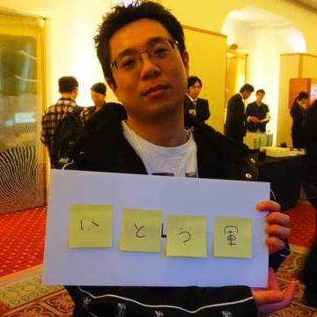
About me
Hiroyuki Ito
(The Hiro)
@hageyahhoo
Test-Driven
Development Group
Notes:
My name is Hiroyuki Ito.
Please call me “The Hiro”.
I’m from Japan.
I belong to “Test-Driven Development Group” in Rakuten.
I have 2 certifications of Scrum.
Now I’m working as an Agile Coach.

Slide 3
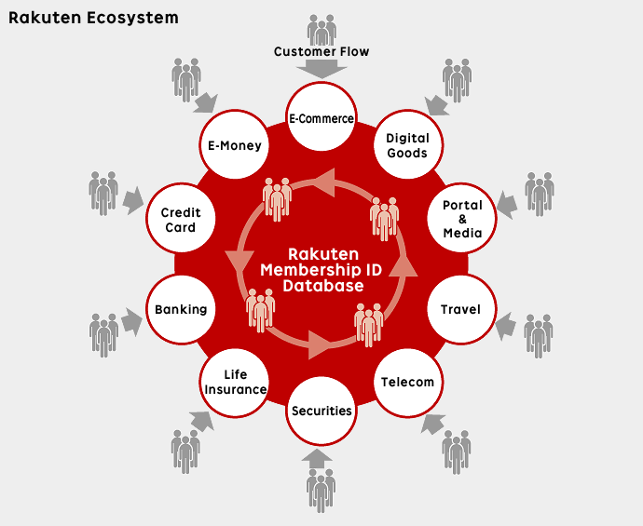
http://global.rakuten.com/corp/about/strength/business_model.html
Notes:
About Rakuten.
Rakuten is an e-commerce company from Japan.
We provide so many services like this.

Slide 4
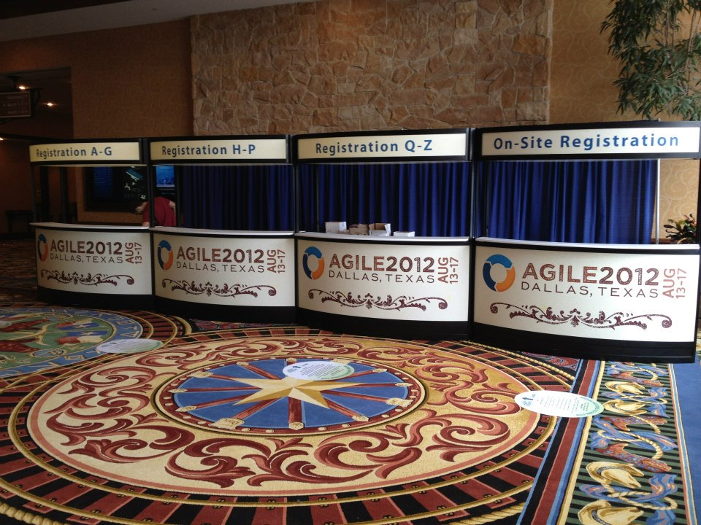
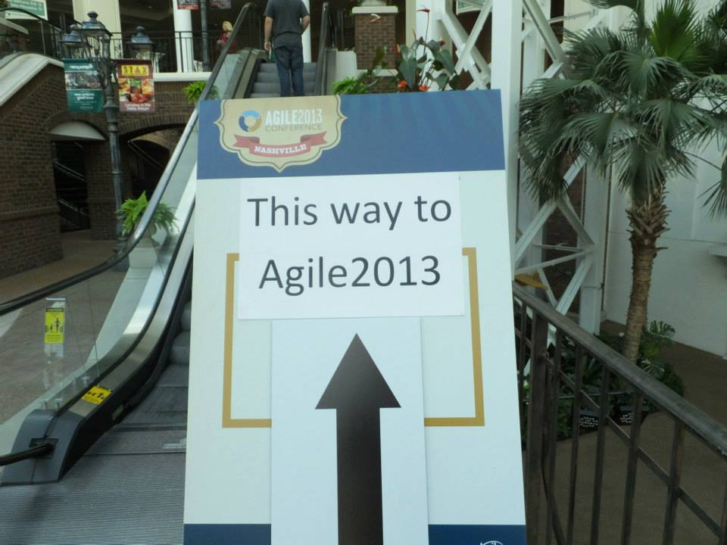
It’s my 3rd time to be here!
Agile2014 : as a Speaker
Notes:
Today, I’m here as a speaker.

Slide 5
This session’s theme
Technology-
Driven
Development
Notes:
Again, this session’s theme is “Technology-Driven Development”.
Of course, this name is derived from “Test-Driven Development”.
Anyway, what is “Technology-Driven Development”?

Slide 6
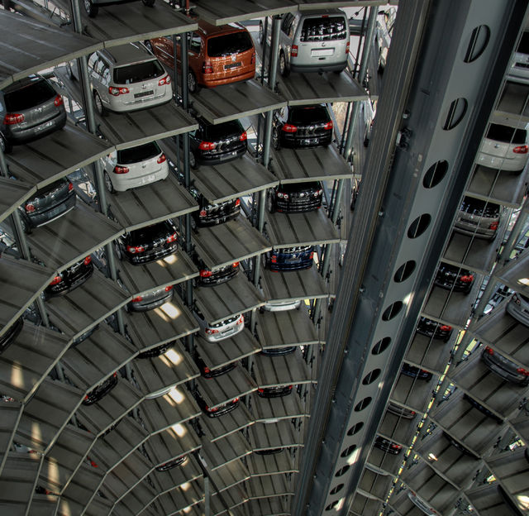
Additional possibilities of automation
Notes:
It means the new possibilities of Automation.

Slide 7
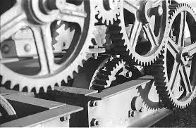
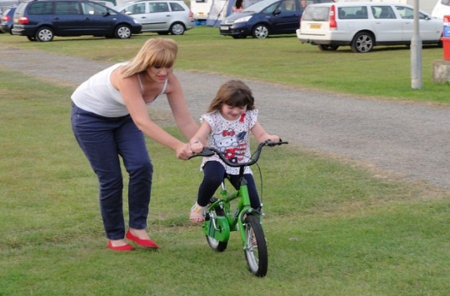

“TDD” stands for three purposes
Efficiency
Learning
Collaboration
Notes:
“Technology-Driven Development” stands for 3 purposes.

Slide 8

By three approaches
CI/CD
TDD
BDD
Notes:
I used these approaches to achieve those purposes.

Slide 9





Three approaches by
CI/CD
TDD
BDD
Notes:
From the tool’s aspect.
I’ll talk the details later.

Slide 10
Agenda
1. Conditions and Challenges
2. CI/CD
3. TDD
4. BDD
5. Results, Problems, Possibility and Future
6. Conclusions
Notes:
Here is this session’s agenda.
At first, I will talk about the conditions and the challenges of my project.
Next, I will explain the concrete approaches, CI/CD, TDD, and BDD.
After that, I will talk about the results, problems, possibilities, and the future of Technology-Driven Development.
At last I will conclude this report.

Slide 11
1. Conditions and Challenges
2. CI/CD
3. TDD
4. BDD
5. Results, Problems, Possibility and Future
6. Conclusions
Notes:
At first, conditions and the challenges of my project.

Slide 12
At the end of April 2013
HELP!
Developers
Business
Analyst
UI/UX
Designers
Agile Coach
(The Hiro)

Slide 13

Our target application is
Notes:
Our product was Android!

Slide 14
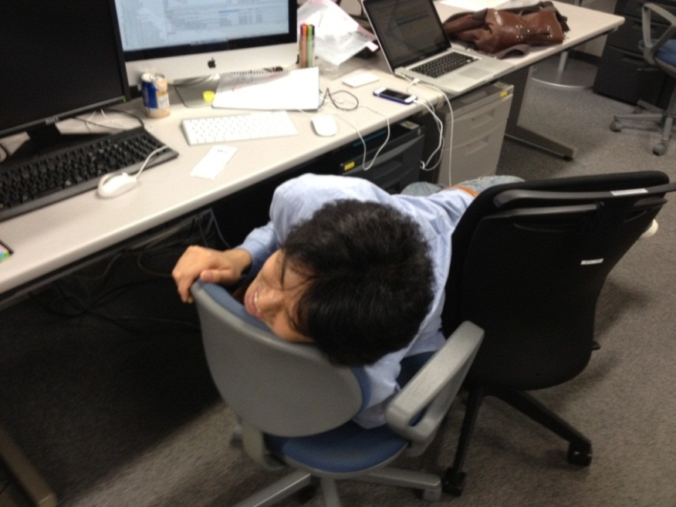
Conditions and Challenges
None of the team members had
any experience with agile
There had been
many manual operations
Most of the team members
were young and immature
Notes:
These are top 3 challenges.

Slide 15
What do you think?
Notes:
If you are in the same position.

Slide 16
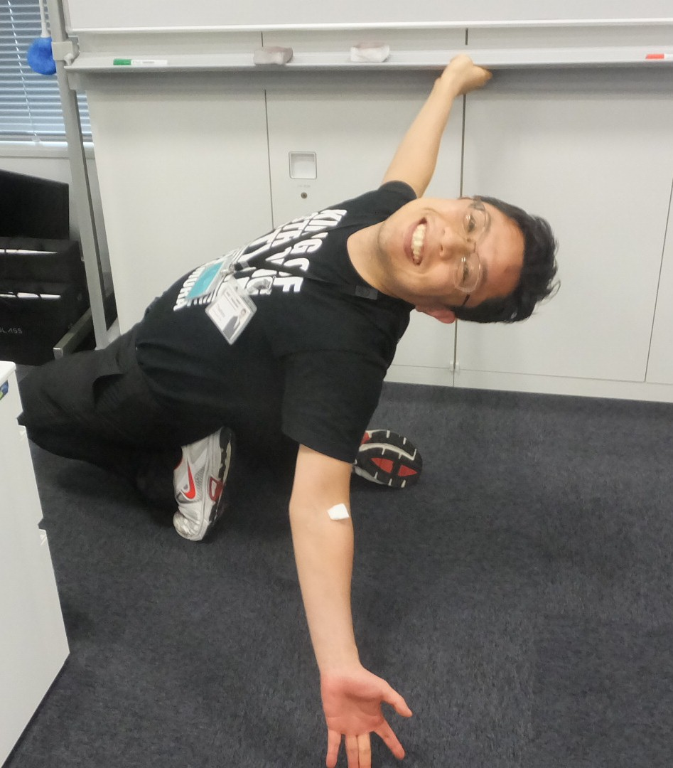
I was so much excited!
Notes:
In Japanese, YeaOh!

Slide 17
WHY?
I can
achieve anything through such a challenging project!
Notes:
Therefore, I was highly-motivated!

Slide 18
Three approaches
CI/CD
TDD
BDD
Notes:
So, I tried to improve the project with these three approaches.

Slide 19
1. Conditions and Challenges
2. CI/CD
3. TDD
4. BDD
5. Results, Problems, Possibility and Future
6. Conclusions
Notes:
Next, about CI/CD.

Slide 20
Challenges
Low performance
So many manual tasks
Going in circles
No clear vision and no requirements
No timely progress information
Notes:
At first, we tried to get over these challenges.

Slide 21
Before CI/CD
13.5 hours/week
Change requests : 3 times/week
Regression testing : 4 hours/change
Need to retry if we find bugs…
Install applications : 0.5 hour/change
5-minite work for 6 persons
Notes:
We tried to measure the current status like this.

Slide 22

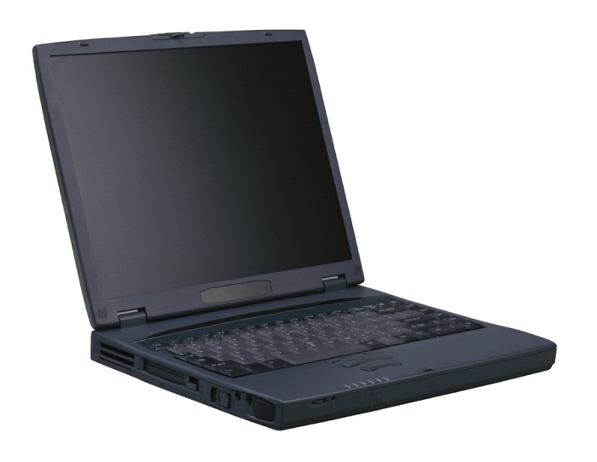

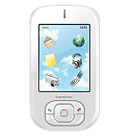
The Implementation of CI/CD in our project
Check-in build (hourly)
My PC
Deliver to
all team members
automatically
Build applications
and run regression tests automatically
We demonstrate latest application
to the business analyst and managers
in every daily scrum

Slide 23
Shared understanding by the working software
Developers
Business
Analyst
Know about
the progress
Get fast feedback
UI/UX
Designers

Slide 24
After CI/CD
15 minutes/week
13 hours!
Change requests : 3 times/week
Regression testing : 3 minutes/change
Install applications : 2 minutes/change

Slide 25
1. Conditions and Challenges
2. CI/CD
3. TDD
4. BDD
5. Results, Problems, Possibility and Future
6. Conclusions
Notes:
Next, TDD.

Slide 26
Challenge
Lack of skill and knowledge of Android
the architecture of Android
how to develop the Android application
how to access the database on the device
how to implement the UI
Notes:
Our challenge is very simple : we did not have enough skill and knowledge of Android at that time.

Slide 27
Before TDD
Dao
DB
Model
Controller
Dao
DB
Activity
Dao
DB
Could not test after we implemented all components
(Debug Later Programming)
It took five days to implement one activity set

Slide 28

Too difficult to use Android JUnit 😐
java.lang.RuntimeException: Stub! (ﾟДﾟ)
Why we need an emulator or a device? :-o
Please don’t start a heavy lifecycle of Android for each test case :-<

Slide 29
Solution to do TDD on Android
Robolectric : Do all unit testing only on JVM
http://robolectric.org/
Without any emulator or device!
Mockito : Can use the “Test Double”
http://code.google.com/p/mockito/
Notes:
Finally, we adopted the new test harness for Android.

Slide 30
Image of Unit testing for Dao by using Robolectric
@Before
public void setUp() {
Create database for Test;
Insert test data;
}
@Test
public void findXxx() {
Assertions;
}
@After
public void tearDown() {
Drop Database for Test;
}
5 minutes -> 0.5 seconds
to run each test case.

Slide 31
After TDD
Dao
DB
Model
Controller
Dao
DB
Activity
Dao
DB
Can test each component independently and separately
It takes one day to implement one activity set (five times faster than at the start of the project)

Slide 32
1. Conditions and Challenges
2. CI/CD
3. TDD
4. BDD
5. Results, Problems, Possibility and Future
6. Conclusions

Slide 33
Challenges
Avoid feature creep
Detect bugs and regressions
on use-cases
Learn domain knowledge effectively
Notes:
So, I tried to improve the project with these three approaches.

Slide 34
Example of feature creep
DONE!
Need discipline!
Developers
Business
Analyst
NUUN ☹
More features!
More features!
UI/UX
Designers

Slide 35
Calabash-android: improve the discipline
The wrapper of Cucumber for Android
As an executable specification
As a communication tool
Specifying collaboratively with
business analyst, designers and developers
By specification with examples

Slide 36
Example of BDD test scenario with Calabash-Android
Feature : name of all cases
Scenario : name of each case
Feature: Input
Scenario: Input today’s data
Given I kick drumroll
And drumroll show today
When press next
Then I should see ”xxx" screen
When I press keys and calculator should show like this:
| 2 | 2 |
| 0 | 20 |
| 0 | 200 |
| * | 200 |
| 3 | 3 |
| = | 600 |
Then take photo
…
These statements are
RUNNABLE!
We can write data
with table style like this
Notes:
Here is the example of BDD test scenarios.

Slide 37
Process of BDD
Developers
Business
Analyst
We want to…
We want to…
UI/UX
Designers

Slide 38
Process of BDD
GIVEN …
WHEN …
THEN …
Developers
Business
Analyst
Is that right?
MORE!
MORE! MORE!
We want to…
UI/UX
Designers

Slide 39
Process of BDD
GIVEN …
WHEN …
THEN …
Developers
Business
Analyst
Is that right?
MORE!
MORE! MORE!
OK, go ahead!
UI/UX
Designers

Slide 40
Process of BDD
GIVEN …
WHEN …
THEN …
Developers
Business
Analyst
Is it OK?
UI/UX
Designers

Slide 41
Process of BDD
GIVEN …
WHEN …
THEN …
Developers
Business
Analyst
Is it OK?
MORE!
MORE! MORE!
Sure!
UI/UX
Designers

Slide 42
After BDD
Bugs : -67%
Change requests : -70%
Improved!
Regressions : -60%

Slide 43
1. Conditions and Challenges
2. CI/CD
3. TDD
4. BDD
5. Results, Problems, Possibility and Future
6. Conclusions
Notes:
Next, I’d like to evaluate “Technology-Driven Development”.

Slide 44
Results
Notes:
Of course, we achieved the target!

Slide 45
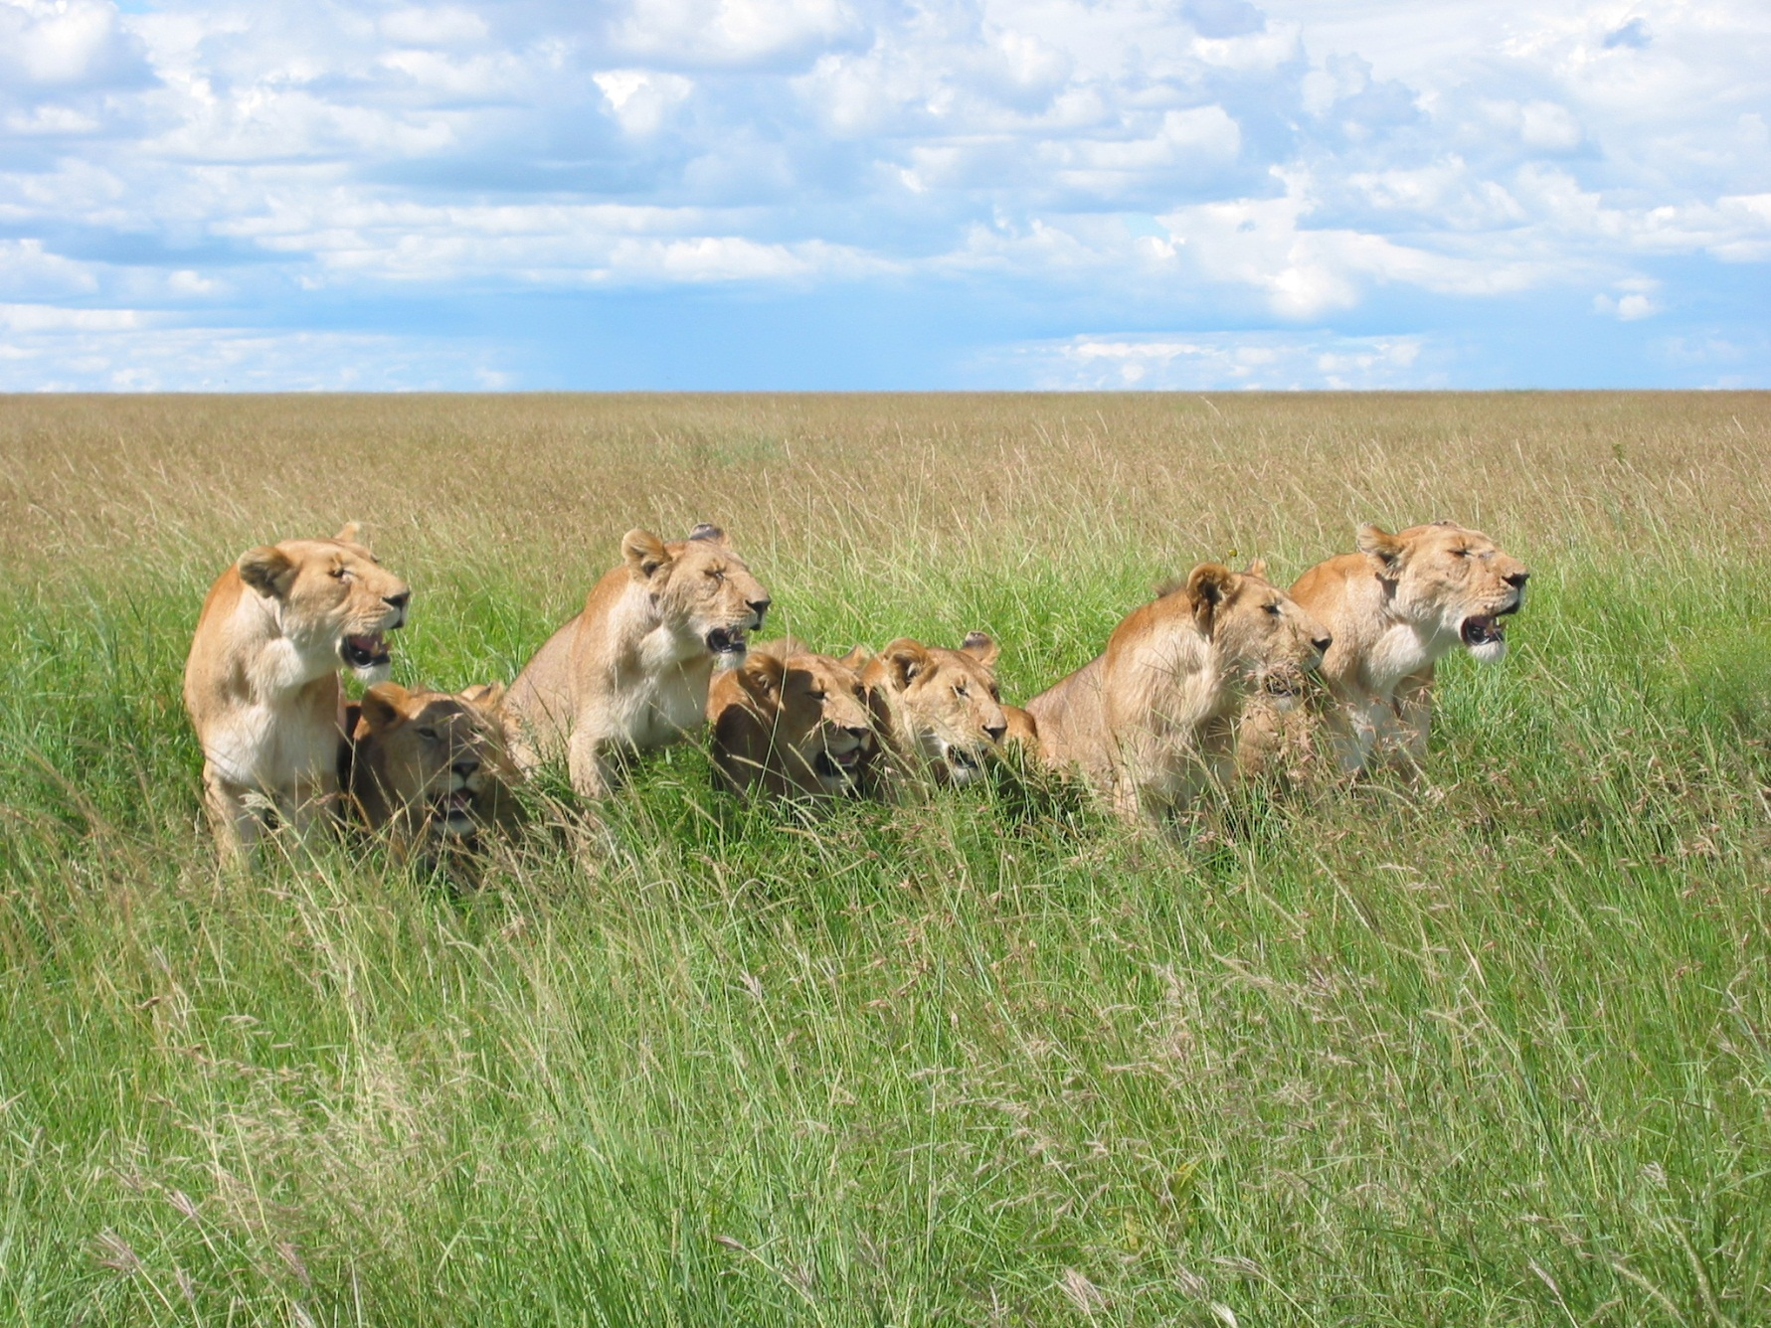
Challenges

Slide 46
[Example] Changing scope
No!
Do all we planned
at first!
Developers
Business
Analyst
Please change scope!
Please change scope!
Please change scope!
UI/UX
Designers
Agile Coach
(The Hiro)

Slide 47
[Example] Changing scope
It’s impossible
to change the scope
within our company…
Developers
Business
Analyst
Belong to
another (subsidiary) company
UI/UX
Designers
Agile Coach
(The Hiro)

Slide 48
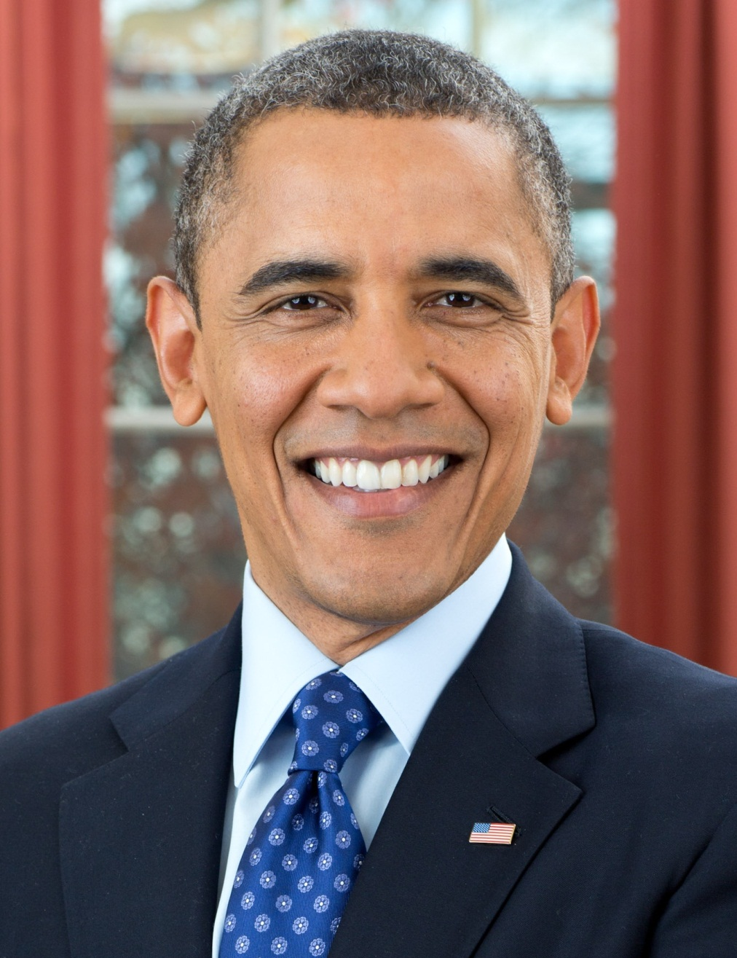
Asked for one executive
YES, YOU CAN!
We changed scope!

Slide 49
Point
Technical excellence and working software
are not the only way to improve projects.
Anything is OK for improving your situation!
(Anything goes/Vale tudo)

Slide 50
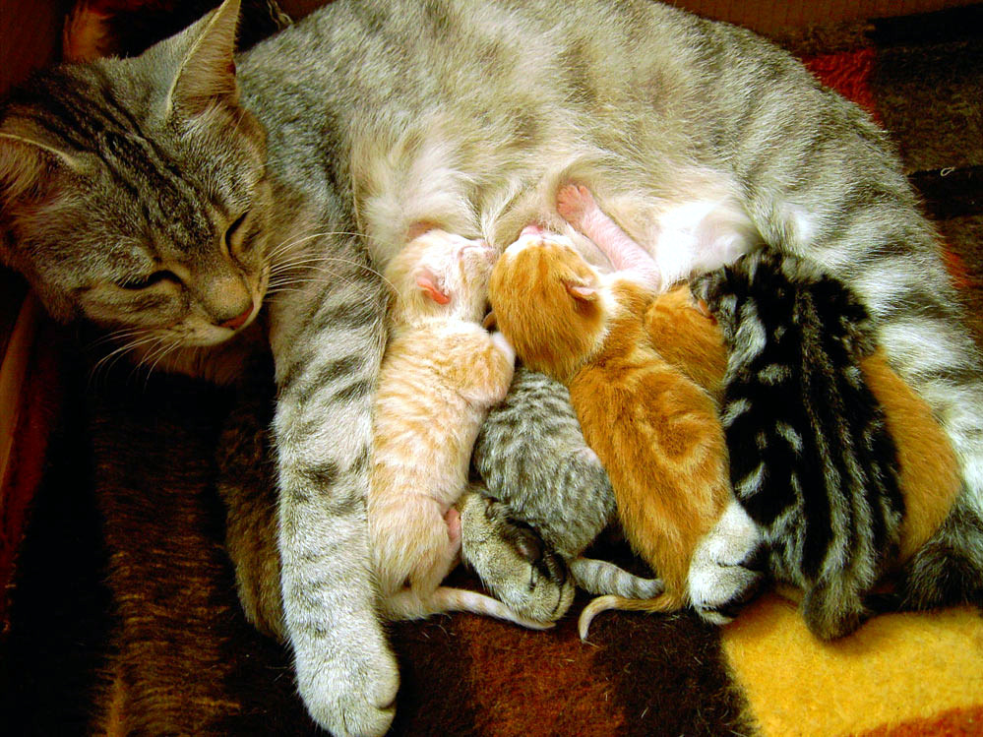
Possibility and future

Slide 51
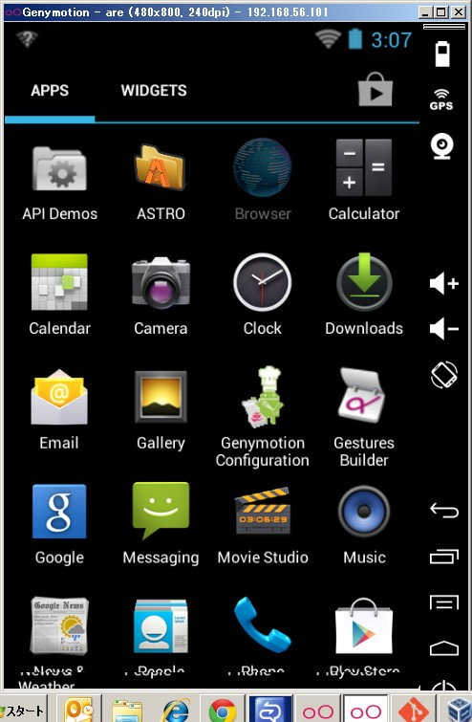
[Example] Growing a collaborative culture
Got some slack time!
How about
Genymotion?
Developers
Too slow
emulator…
Over 10 times faster
Can run via Calabash-Android
Notes:
I’d like to share the example of the collaborative culture by Technology-Driven Development in our team.
Automation nurtures the team members.

Slide 52
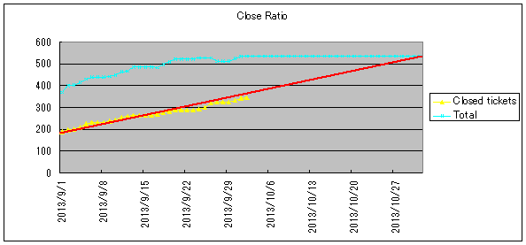
Can enhance “TDD” by numerical measurement
[e.g.]
Change requests : 3 times/week
Regression testing : 3 minutes/change
Install applications : 2 minutes/change

Slide 53
Use “TDD” as a measure for total optimization
Developers
Executive
Business
Analyst
Agile Coach
(The Hiro)
UI/UX
Designers
Manager
Over barriers/silos

Slide 54

Don’t lose the whole picture!

Slide 55
1. Conditions and Challenges
2. CI/CD
3. TDD
4. BDD
5. Results, Problems, Possibility and Future
6. Conclusions
Notes:
At last, conclude this session.

Slide 56
Three purposes
Efficiency
Learning
Collaboration
Notes:
“Technology-Driven Development” has 3 purposes.

Slide 57
Three approaches
CI/CD
TDD
BDD
Notes:
I used these approaches to achieve those purposes.

Slide 58
Three approaches by
CI/CD
TDD
BDD
Notes:
From the tool’s aspect.

Slide 59
We found this practice
through the project
with passionate members
with a lot of trial and error

Slide 60
Experience from Gemba
現場主義
Notes:
This “Gemba-shugi” is my Agile.

Slide 61
Find your answer
by yourself
through your experience

Slide 62

Find your treasure!

